Slide 1


Computing
Controlling Devices: Flowol
Year One
Computing | Year 5 | Controlling Devices: Flowol | Multiple Outputs | Lesson 3

Slide 2
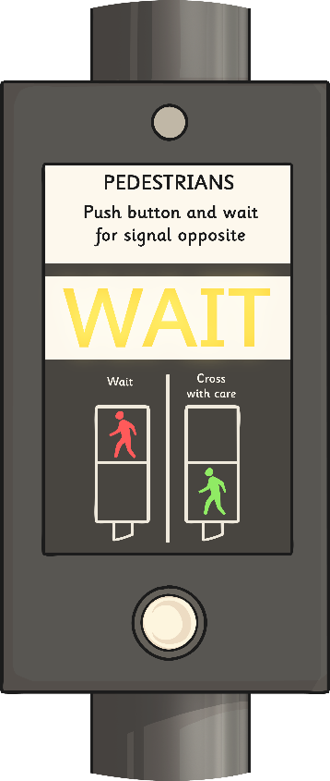



Multiple Outputs

Slide 3
Aim
I can control multiple outputs at the same time.
Success Criteria
I can identify the conventional sequence for a set of traffic lights.
I can create a flowchart to program one set of traffic lights.
I can edit a flowchart to control two sets of traffic lights at the same time.

Slide 4

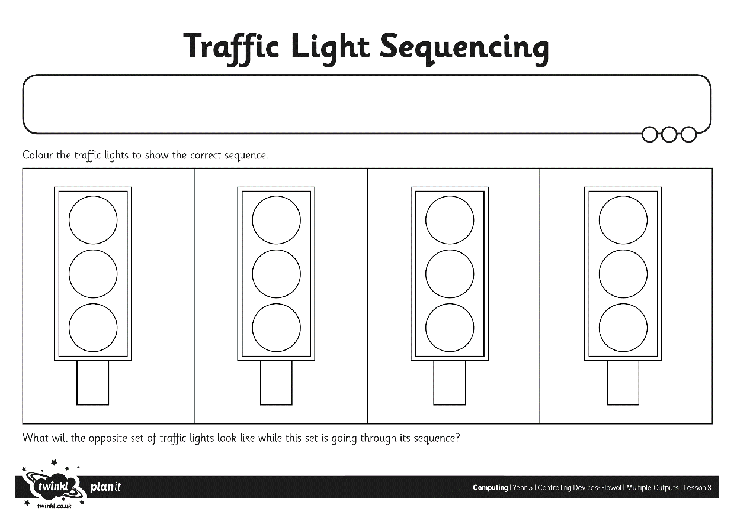
Traffic Light Sequence
Using the activity sheet, colour the lights to show the correct sequence of lights.
Think about which lights follow in what order.
What will the opposite set of lights show during this time?

Slide 5
Traffic Light Sequence
What is the correct sequence for a set of traffic lights changing?
Click on the slide to reveal the correct sequence below.
1
2
3
4
Red
  Red & Amber
Green
  Amber
Note that while this set of traffic lights is going through its sequence
2 to 4, the opposite set will remain at red.

Slide 6

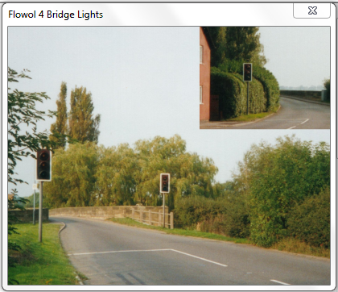
Flowol: Bridge Lights
Open the Flowol software.
Select the mimic ‘Bridge Lights’.
Save as a new file with a
suitable filename.

Slide 7

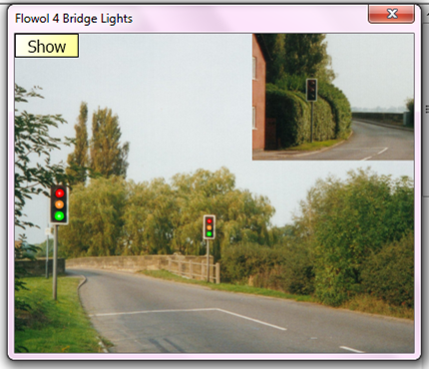
Show and Test Outputs
What are the outputs in the sets of traffic lights?
You can show (or hide) the output labels on a mimic by clicking in the top left corner.
To test an output, just click on it. This makes it appear ‘on’.

Slide 8

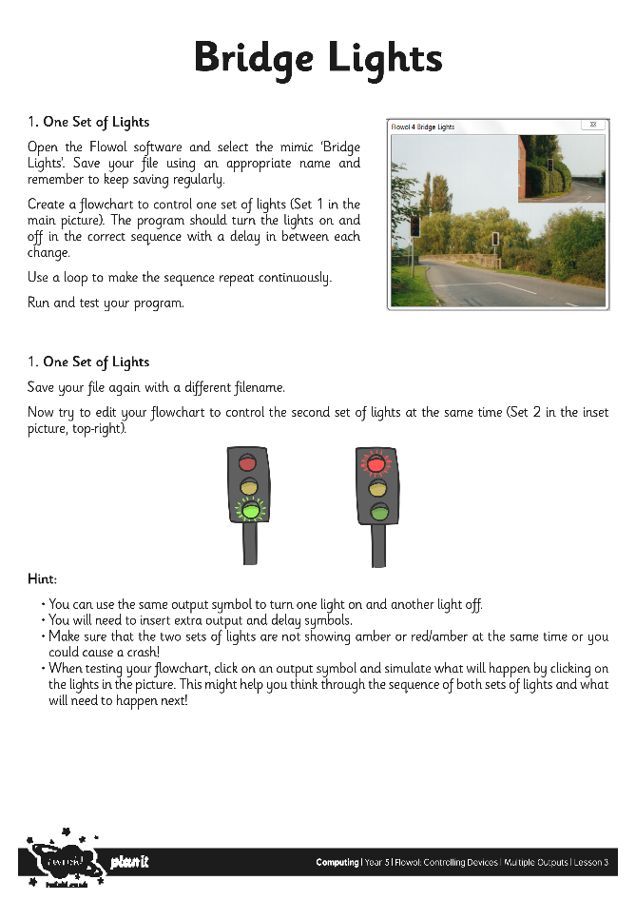
Creating Your Flowcharts
Create the flowchart for the first set of lights (Set 1 in the main window).
Use a loop to make the program repeat continuously.
After you have tested and checked your flowchart, can you edit the symbols to simultaneously control the second set of lights?
Use the activity sheet to help you.

Slide 9

Correcting Mistakes
How do you correct a mistake on a flowchart?
How can you edit a symbol?
How do you remove a symbol?

Slide 10
Check and Edit
We will choose one or more flowcharts to open and view on the interactive whiteboard.
When we run the program, check that the sequence is correct.
If not, can it be debugged and edited to make it work correctly?

Slide 11

Aim
I can control multiple outputs at the same time.
Success Criteria
I can identify the conventional sequence for a set of traffic lights.
I can create a flowchart to program one set of traffic lights.
I can edit a flowchart to control two sets of traffic lights at the same time.

